Slide 1
Developing Classification Models
Train and Tune Classification Models
Evaluate Classification Models

Slide 2

Train and Tune Classification Models

Slide 3






You Are Here (Process, Analyze, Train Models)
Frame the Problem
Identify & Collect Data
Process Data
Analyze Data
Finalize the Project
Train Models

Slide 4
Binary Classification
Binary classification: The task of categorizing data examples as either a 1 or a 0.
A data example:
Is something or is not.
Is on or off.
Exists or doesn't.
Common in a field like health care.
Classifying patients as having a condition (1) or not (0).
Common in identifying equipment failure.
Equipment is about to fail (1) or not (0).
Multiple algorithms can perform binary classification.

Slide 5
Logistic Regression
Data example
Line of best fit
1 (Yes)
Return customer?
0 (No)
Satisfaction score

Slide 6


Logistic Function
Logistic function—A type of sigmoid function used in logistic regression.
Where:
t is the estimation between negative infinity and positive infinity.
e is the natural logarithm base.
Objective is to estimate model parameters.
Values "learned" by model.
Enhance decision-making capabilities.
$$σ(t)=\frac{1}{1+e^{−t}}$$
$$σ(t)=\frac{1}{1+e^{−t}}$$

Slide 7
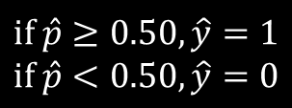
Decision Boundary
$$if \hat{p}≥0.50, \hat{y}=1$$
$$if \hat{p}<0.50, \hat{y}=0$$
Data example
Line of best fit
1 (Yes)
Return customer?
Decision boundary (0.50)
0 (No)
Satisfaction score

Slide 8
Multi-Label Classification
Multi-label classification: A classification scheme in which a data example is given more than one label.
As opposed to binary classification, in which an example is x or is not x.
Classifying written works.
Category 1: Work is either fiction or non-fiction.
Category 2: Work is either for young children or adults.
Classes in each category are mutually exclusive.
Classes between categories are not mutually exclusive.
Work can be: children's fiction, adult fiction, children's non-fiction, adult non-fiction.
Multi-label problems can be solved by training multiple binary classifiers.
Unless labels are correlated.
In written work example, train one model for category 1, another model for category 2.

Slide 9
Multi-Class Classification
Multi-class classification: A classification scheme in which a data example is placed within a single class among three or more choices.
Classes are mutually exclusive.
Example cannot belong to class A and B and C.
Example must belong to A or B or C.
Classifying fictional works based on genre:
Horror
Fantasy
Romance
Etc.
A work is either horror or some other non-horror type; it cannot be both.
Such problems require a unique approach.

Slide 10
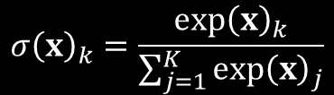

Multinomial Logistic Regression
Multinomial logistic regression: A method for solving multi-class classification problems.
Softmax function determines class with highest probability.
In a story that mentions dragons and wizards, the genre probabilities are:
89% fantasy
8% romance
3% horror
Multinomial logistic regression starts by computing a score, where:
k is the class.
θ is the vector of model parameters.
x is the vector of feature values.
$${\left(x\right)}_{k}={\left(θ^{\left(k\right)}\right)}^{T}∙x$$
Scores are computed for every class, then plugged into the softmax function, where:
σ(x)_{k} is the probability that example x belongs to class k given the earlier score.
K is the total number of classes.
$$σ{\left(x\right)}_{k}=\frac{exp{\left(x\right)}_{k}}{\sum_{j=1}^{K}{exp{\left(x\right)}_{j}}}$$

Slide 11
Guidelines for Training Logistic Regression Models
Consider training logistic regression models to binary classification.
Consider logistic regression for large datasets.
Consider logistic regression to avoid overfitting.
Determine if you have a multi-label classification problem.
Train multiple binary classification models (unless labels are correlated).
Determine if you have a multi-class classification problem.
Train a multinomial logistic regression model.

Slide 12
Training a Logistic Regression Model

Slide 13
k-Nearest Neighbor (k-NN) (Slide 1 of 2)
k-nearest neighbor: An algorithm that classifies data examples based on their closeness to each other.
"Closeness" is distance between data points mapped to feature space.
Takes a plurality vote of neighboring points to determine classification.
Compared to logistic regression:
Simpler to implement.
Doesn't truly "learn" parameters through training.
Outputs a direct classification instead of a probability.
Performs poorly on large datasets.

Slide 14
k-Nearest Neighbor (k-NN) (Slide 2 of 2)
$$k=3$$
Class 0
Class 1
Example
Surface Area
Class 0 wins vote
Max Depth

Slide 15
k Determination (Slide 1 of 2)
Choice of k dependent on data and output you're looking for.
No perfect value of k in all circumstances.
The larger k is, the less impact anomalies and mislabeled examples have.
Less distinct boundaries.
More computational overhead.
The opposite is true for smaller k values.
Always make k odd when you have a binary problem.
Prevents tie vote.
Bootstrapping takes square root of total number of data examples to determine k.
Cross-validation can also help you determine k.

Slide 16

k Determination (Slide 2 of 2)
$$k=5$$
Class 0
Class 1
Example
Class 1 wins vote
Surface Area
Max Depth

Slide 17
Guidelines for Training k-NN Models
Consider that lower k values make classification boundaries more distinct but less effective at minimizing noise, and vice versa.
Consider making k odd for binary classification problems.
Consider using a bootstrapping method to select a good k value.
Consider using cross-validation to select a good k value.
Consider using k-NN over logistic regression when simplicity of implementation is important, and when working with smaller datasets.

Slide 18
Training a k-NN Model

Slide 19
Support-Vector Machines (SVMs)
Decision boundary
Class 0
2.0
Class 1
Support vector
1.0
Support-vector margin
Support-vector margin
Support vector
0.0
0.0
1.0
2.0

Slide 20
SVMs for Linear Classification (Slide 1 of 2)
Logistic Regression
Linear Classification with SVMs
2.0
2.0
1.0
1.0
0.0
0.0
0.0
1.0
2.0
0.0
1.0
2.0

Slide 21
SVMs for Linear Classification (Slide 2 of 2)
Logistic Regression
Linear Classification with SVMs
2.0
2.0
1.0
1.0
Test example class = 0
Test example class = 1
0.0
0.0
0.0
1.0
2.0
0.0
1.0
2.0

Slide 22
Hard-Margin Classification (Slide 1 of 2)
2.0
1.0
Hard margin not possible due to outliers
0.0
0.0
1.0
2.0

Slide 23
Hard-Margin Classification (Slide 2 of 2)
2.0
1.0
Margin gap too small
Outlier
0.0
0.0
1.0
2.0

Slide 24
Soft-Margin Classification
2.0
1.0
Larger gap at expense of allowing some outliers within margins
0.0
0.0
1.0
2.0

Slide 25
Guidelines for Training SVM Classification Models
Consider SVMs when your problem is sensitive to outliers.
Recognize the goal of SVM classification is to keep examples outside wide margins.
Tune the regularization hyperparameter to adjust margin size.
Consider that narrow margins may lead to overfitting.
Consider softening the margins to avoid overfitting.
Recognize that softening the margins has a tradeoff.
Scale training data so distance calculations are based on the distribution of data.

Slide 26
Training an SVM Classification Model

Slide 27

Naïve Bayes
Bayes' theorem—Used by naïve Bayes classifiers for class probability estimation.
Where:
y is the observed classification.
x is the vector of dataset features.
p(y|x) is the likelihood of y given x (posterior probability).
p(x|y) is the likelihood of x given y.
p(y) is the probability of y independent of the data (prior probability).
p(x) is the probability of x independent of the data.
$$p\left(y|x\right)=\frac{p\left(x|y\right)p\left(y\right)}{p\left(x\right)}$$
$$σ(t)=\frac{1}{1+e^{−t}}$$

Slide 28
Naïve Bayes Example (Slide 1 of 2)
Customer retention example:
Satisfaction | Returning?
Satisfied | Yes
Not satisfied | No
Very satisfied | Yes
Not satisfied | Yes
Not satisfied | No
Satisfied | No
Very satisfied | Yes
Satisfied | Yes
Satisfied | Yes
Satisfied | Yes
Satisfied | Yes

Slide 29

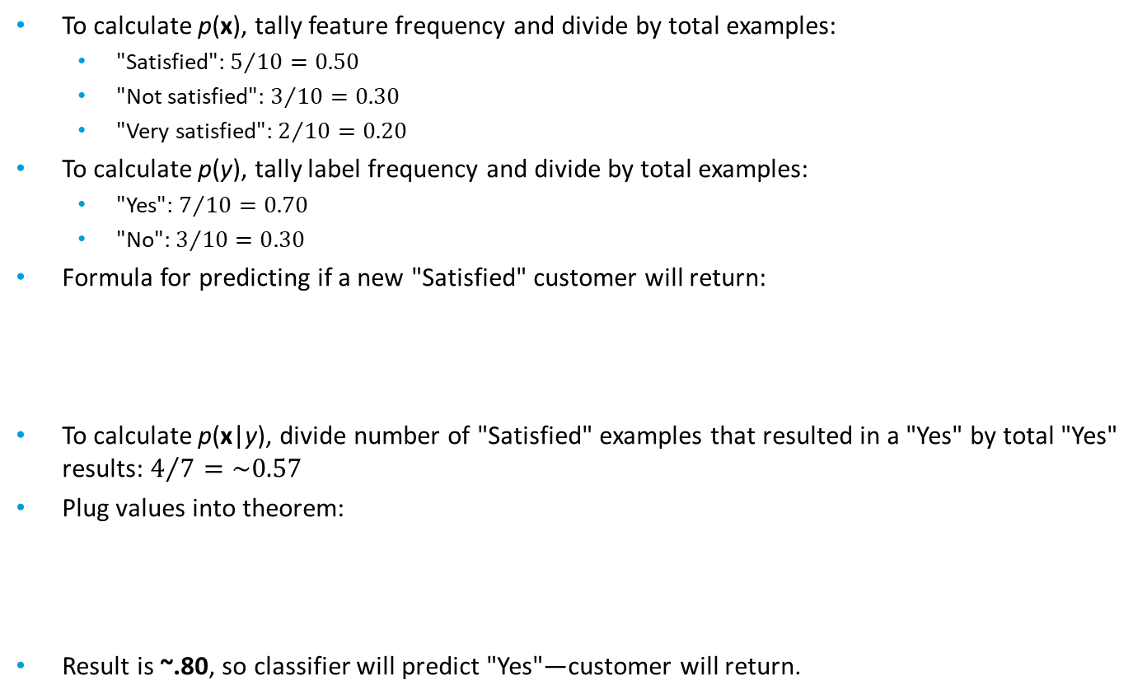

Naïve Bayes Example (Slide 2 of 2)
To calculate p(x), tally feature frequency and divide by total examples:
"Satisfied": $5/{10}=0.50$
"Not satisfied": $3/{10}=0.30$
"Very satisfied": $2/{10}=0.20$
To calculate p(y), tally label frequency and divide by total examples:
"Yes": $7/{10}=0.70$
"No": $3/{10}=0.30$
Formula for predicting if a new "Satisfied" customer will return:
To calculate p(x|y), divide number of "Satisfied" examples that resulted in a "Yes" by total "Yes" results: $4/7=\sim 0.57$
Plug values into theorem:
Result is ~.80, so classifier will predict "Yes"—customer will return.
$$p\left(Yes|Satisfied\right)=\frac{p\left(Satisfied|Yes\right)p\left(Yes\right)}{p\left(Satisfied\right)}$$
$$p\left(Yes|Satisfied\right)=\frac{0.57∙0.70}{0.50}$$

Slide 30
Naïve Bayes Classification Characteristics
"Naïve" means features are assumed to be conditionally independent.
One feature does not interact with the others.
"Purchase price" and "Quantity purchase" interact, so this would not be suitable.
It is rare to find a problem/dataset with completely independent features.
If you do, naïve Bayes classifiers can significantly outperform logistic regression.
Real-world applications:
Spam filtering—analyzes text components independently to classify email messages as "spam" or "not spam."
Sentiment analysis—determines satisfaction with product/service based on social media posts.
There are multiple types of naïve Bayes classifiers.
Differ based on how they treat the distribution of p(x|y).
Examples: Gaussian naïve Bayes, multinomial naïve Bayes, etc.

Slide 31
Guidelines for Training Naïve Bayes Models
Use naïve Bayes when variables have minimal or no dependency or relationship to each other.
Consider using naïve Bayes when speed of training/prediction generation are important.
Encode categorical features to integers.
Consider discretizing variables that have a large number of distinct observations.
Create a new feature for a combination of features that does not already exist in the dataset.

Slide 32
Training a Naïve Bayes Model

Slide 33
Decision Tree
Satisfaction score > 4
Yes
No
Initial purchase > $100
Not returning
Yes
No
Returning
Customer age > 24
Yes
No
Returning
Not returning

Slide 34

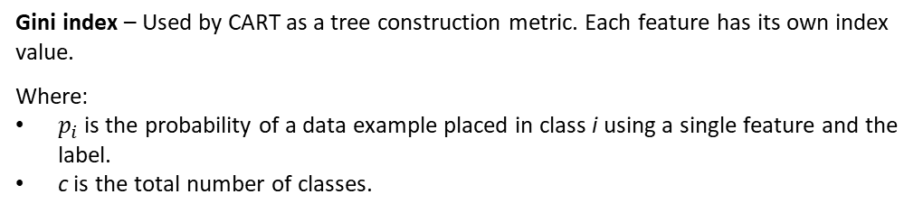
Classification and Regression Tree (CART)
$$G=1−\sum_{i=1}^{c}{{\left(p_{i}\right)}^{2}}$$
Gini index – Used by CART as a tree construction metric. Each feature has its own index value.
Where:
$p_{i}$ is the probability of a data example placed in class i using a single feature and the label.
c is the total number of classes.
Gini index splits training set into two based on a feature with a threshold.
Example: Split "Satisfaction score" based on greater than 4.
Gini index determines purity of decision node.
Purest node is one in which all examples at decision node belong to either class.
Most impure node is when there is a 50–50 split.
Feature with highest purity (G = 0) is root node.

Slide 35
Gini Index Example (Slide 1 of 3)
Initial purchase > $100 | Satisfaction score > 4 | Customer age > 24 | Returning
Yes | Yes | No | Yes
No | Yes | No | No
No | No | Yes | No
Yes | No | No | No
No | Yes | Yes | Yes
Yes | Yes | Yes | Yes
Yes | No | No | Yes
No | Yes | No | Yes

Slide 36
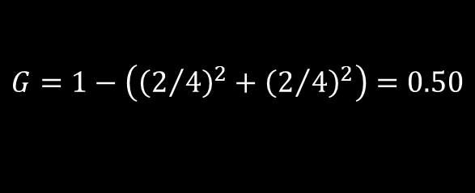
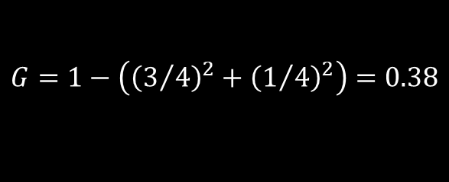
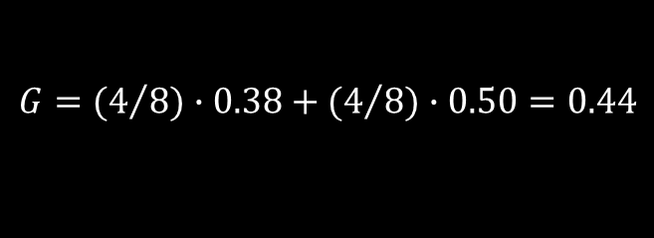
Gini Index Example (Slide 2 of 3)
Calculate Gini index for "Initial purchase" = "Yes".
Calculate Gini index for "Initial purchase" = "No".
Weighted sum of both:
$$G=1−\left({\left(3/4\right)}^{2}+{\left(1/4\right)}^{2}\right)=0.38$$
$$G=1−\left({\left(2/4\right)}^{2}+{\left(2/4\right)}^{2}\right)=0.50$$
$$G={(4}/{8)∙0.38+{(4}/{8)∙0.50=0.44}}$$

Slide 37
Gini Index Example (Slide 3 of 3)
Process is repeated for other two features.
When calculated, the resulted indices are:
Initial purchase = 0.44
Satisfaction score = 0.37
Customer age = 0.49
"Satisfaction score" has lowest index, so it will be root decision node.
This Gini index is only relevant for the root node.
CART splits data into another subset, recalculating Gini and evaluating purity again.
Repeats process for sub-subsets, etc.
Splitting stops when:
There's no more impurity to reduce.
Tree reaches maximum depth specified in hyperparameter.

Slide 38
Customer Retention Example Tree
Satisfied <= 0.5
Samples = 8
T: 3 | F: 5
Class: Returning
Initial purchase <= 0.5
Samples = 3
T: 2 | F: 1
Class: Not returning
Customer age <= 0.5
Samples = 5
T: 1 | F: 4
Class: Returning
Samples = 1
T: 1 | F: 0
Class: Not returning
Samples = 2
T: 1 | F: 1
Class: Not returning
Initial purchase <= 0.5
Samples = 3
T: 1 | F: 2
Class: Returning
Samples = 2
T: 0 | F: 2
Class: Returning
Samples = 1
T: 0 | F: 1
Class: Returning
Samples = 2
T: 1 | F: 1
Class: Not returning

Slide 39
CART Hyperparameters
Hyperparameter | Description
max_depth | Number of decision nodes from root to farthest leaf. If not specified, CART will keep splitting until: G for all leaves is 0. All nodes are less than min_samples_split. Regularizes training to avoid overfitting.
min_samples_split | Number of data examples required to split a decision node. Increase to constrain model, reduce overfitting. Beware of constraining model too much, underfitting it.
min_samples_leaf | Number of data examples required to be at a leaf node. Increase to reduce overfitting. Beware of underfitting.
splitter | "best" (default) calculates Gini index. "random" splits feature at random and then calculates Gini index. Repeats process and finds split with best Gini index. Random requires less overhead. Random may be better at avoiding overhead in certain cases. Random does not always make optimal splitting decisions.

Slide 40
Pruning
Pruning: The process of reducing the overall size of a decision tree.
Eliminates nodes, branches, and leaves that provide little value to the task at hand.
Helps minimize overfitting.
Specifying hyperparameters like max depth is "pre-pruning."
Three major post-pruning methods:
Reduced-error pruning
Relatively quick and efficient; a good first option.
Minimum error pruning
Does not involve a test dataset, but performs poorly as number of classes increases.
Cost complexity pruning
Performs well, but not usually as quick as reduced-error pruning.

Slide 41
Ensemble Learning
Ensemble learning: A type of machine learning in which estimations from multiple models are considered in combination.
Intended to obtain a more skillful estimation than one model in isolation.
Aggregating multiple models usually leads to better estimations.
Example: Train several models for customer retention decision.
Choosing the one with the best score isn't always the best approach.
In ensemble learning, the classification that gets the most votes wins.
Example training results:
Logistic regression: 78%, Class 1
Naïve Bayes: 86%, Class 0
CART: 81%, Class 1
Ensemble would choose class 1, even though naïve Bayes had highest accuracy.
Consider how rolling a die 100,000 times will likely give you a more even probability distribution than rolling it 100 times.

Slide 42
Random Forest
Data Example
Class 1
Class 0
Class 0
Mode = Class 0

Slide 43

Gradient Boosting
Gradient boosting: An ensemble algorithm that builds decision trees iteratively, where each new tree reduces the errors of the previous tree.
Past trees influence how new trees are built.
Different than random forests, which build trees independently.
Builds weak learners, which eventually lead to strong learners.
Starts by generating a base classification probability for initial decision tree:
Example: 5 returning customers, 3 not returning.
Probability is 0.625.
Initial tree makes this estimation for all examples.
All customers are predicted to return.
A weak learner at this point.
$$p=\frac{e^{\log\left(odds\right)}}{1+e^{\log\left(odds\right)}}$$

Slide 44

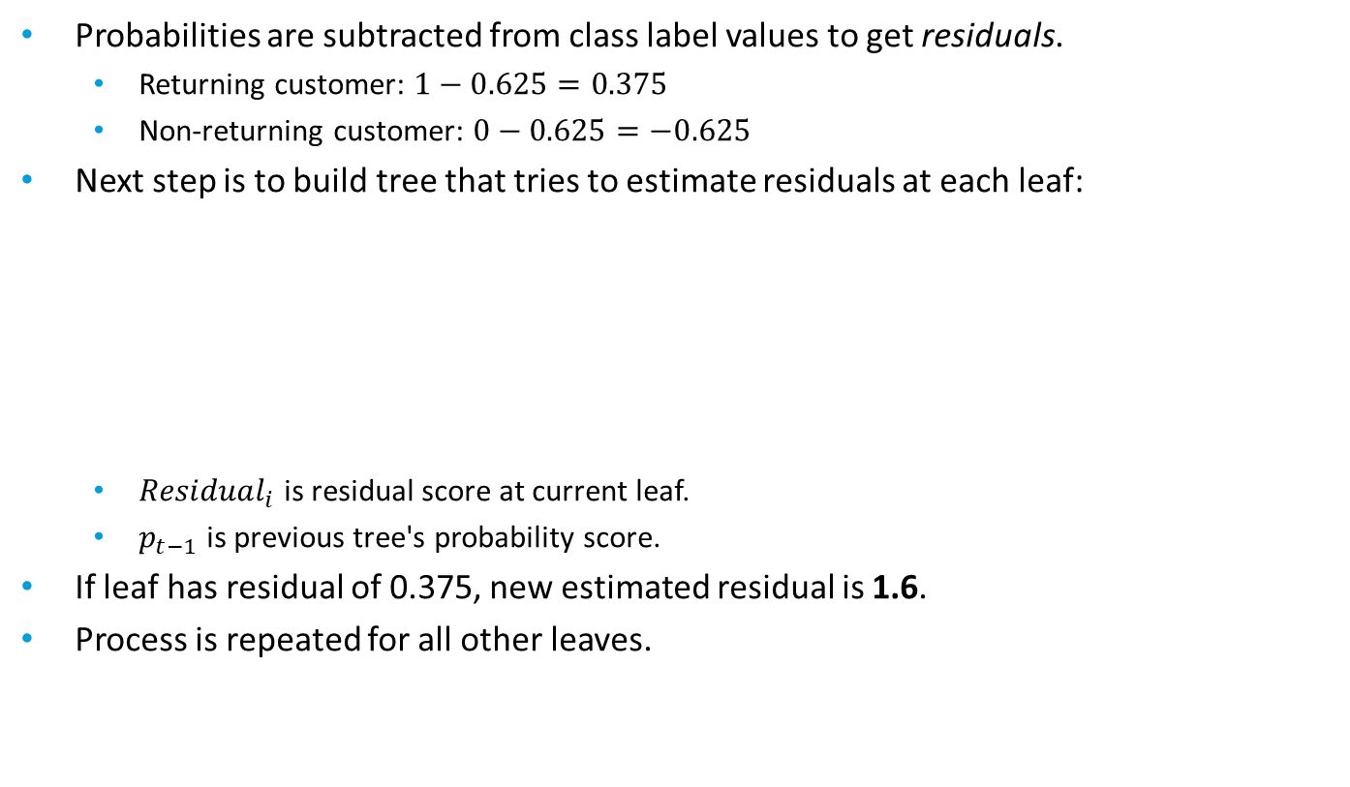
Gradient Boosting: Residuals (Slide 1 of 2)
Probabilities are subtracted from class label values to get residuals.
Returning customer: $1−0.625=0.375$
Non-returning customer: $0−0.625=−0.625$
Next step is to build tree that tries to estimate residuals at each leaf:
${Residual}_{i}$ is residual score at current leaf.
$p_{t−1}$ is previous tree's probability score.
If leaf has residual of 0.375, new estimated residual is 1.6.
Process is repeated for all other leaves.
$$\frac{\sum{{Residual}_{i}}}{\sum{\left[p_{t−1}∙\left(1−p_{t−1}\right)\right]}}$$

Slide 45

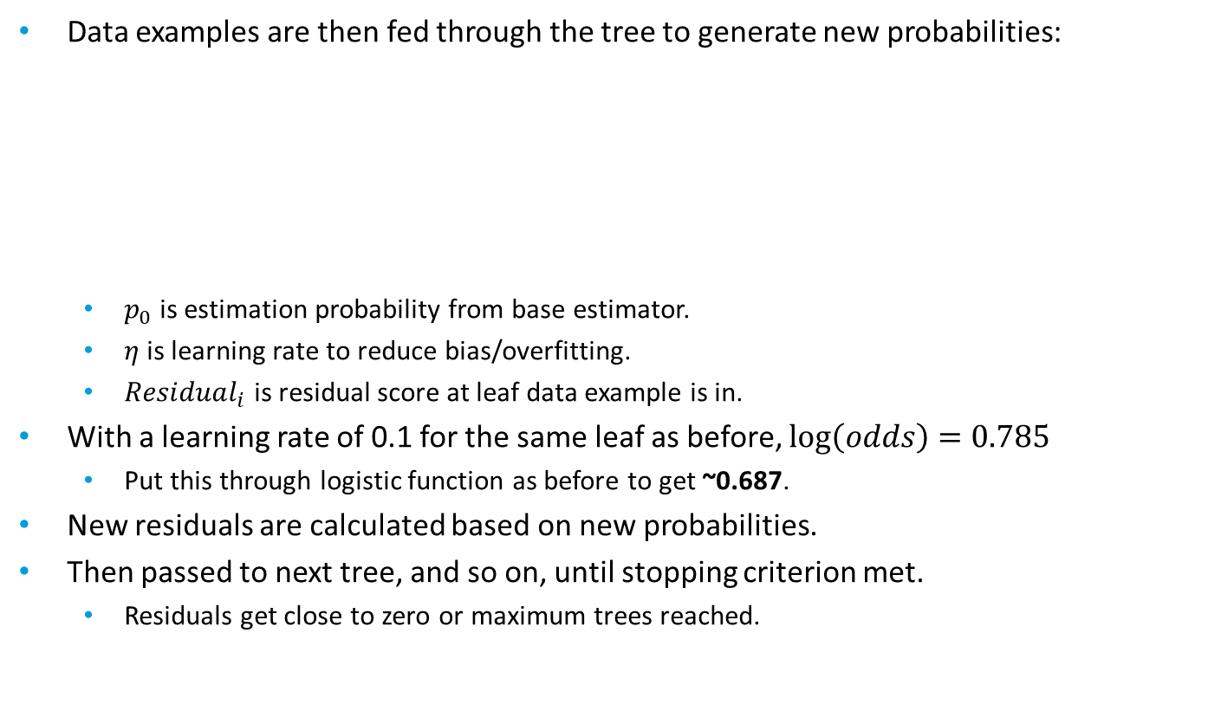
Gradient Boosting: Residuals (Slide 2 of 2)
Data examples are then fed through the tree to generate new probabilities:
$p_{0}$ is estimation probability from base estimator.
$η$ is learning rate to reduce bias/overfitting.
${Residual}_{i}$ is residual score at leaf data example is in.
With a learning rate of 0.1 for the same leaf as before, $\log\left(odds\right)=0.785$
Put this through logistic function as before to get ~0.687.
New residuals are calculated based on new probabilities.
Then passed to next tree, and so on, until stopping criterion met.
Residuals get close to zero or maximum trees reached.
$$p_{0}+\left(η∙{Residual}_{i}\right)$$

Slide 46
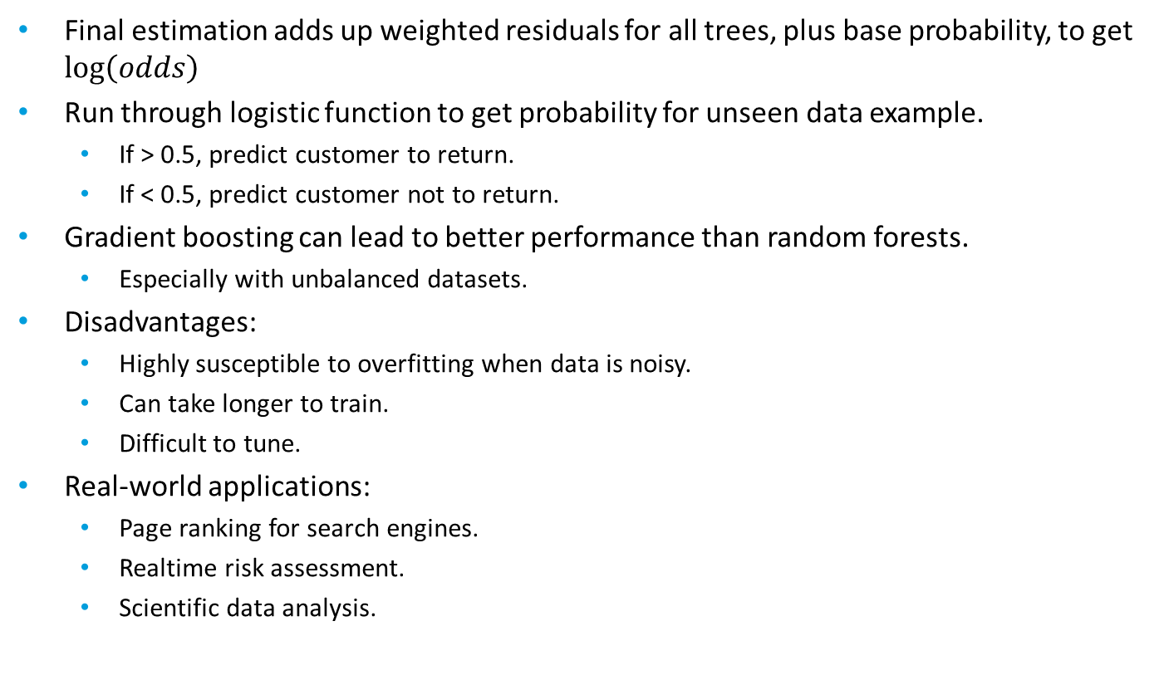
Gradient Boosting: Estimations
Final estimation adds up weighted residuals for all trees, plus base probability, to get $\log\left(odds\right)$
Run through logistic function to get probability for unseen data example.
If > 0.5, predict customer to return.
If < 0.5, predict customer not to return.
Gradient boosting can lead to better performance than random forests.
Especially with unbalanced datasets.
Disadvantages:
Highly susceptible to overfitting when data is noisy.
Can take longer to train.
Difficult to tune.
Real-world applications:
Page ranking for search engines.
Realtime risk assessment.
Scientific data analysis.

Slide 47
Guidelines for Training Classification Decision Trees and Ensemble Models
Decision trees:
Use decision trees for keeping a model simple and easy to understand.
Consider that you may not need to prepare the data as much as with other algorithms.
Consider one-hot encoding categorical variables first.
Consider that you may need to discretize continuous variables.
Be aware that they are prone to overfitting.
Perform pre-pruning techniques to reduce overfitting.
Use post-pruning methods to reduce overfitting as well.
Random forests:
Use random forests to improve estimative skill and reduce overfitting.
Use bagging to perform data sampling.
Consider that cross-validation is unnecessary with bagging.
Use most of the same pre-pruning hyperparameters as with decision trees.
Consider limiting the number of trees in the forest to a few hundred.
Use random forests for feature selection.
Gradient boosting:
Consider using over random forests if you have unbalanced data.
Be aware of its tendency to overfit to noisy data.
Be aware that it can take longer to train.

Slide 48
Training Classification Decision Trees and Ensemble Models

Slide 49
Hyperparameter Optimization
Hyperparameter optimization: The process of repeatedly altering hyperparameters that an algorithm uses to train a model to determine the hyperparameters that lead to the best or desired level of model performance.
You can try tuning the hyperparameters manually.
This can get tedious and is prone to error.
Automated optimization methods:
Grid search
Randomized search
Bayesian optimization

Slide 50
Grid Search
Grid search: A hyperparameter optimization method that takes a grid of parameter combinations, trains a model using each one, then returns the best combination that optimizes an evaluation metric.
You supply which metric you want to optimize on.
Can also use cross-validation to derive parameters by training over several folds.
Example parameter grid:
grid = [{'max_depth': [5, 6, 7],
'min_samples_split': [10, 50, 100],
'min_samples_leaf': [10, 50, 100]}]
Each is a separate hyperparameter.
Will train on dataset 3 × 3 × 3 = 27 times.
Example search object:
search = GridSearchCV(model, param_grid = grid, scoring = 'accuracy', cv = 5)
Will do 5-fold cross-validation for each combination.
Trains 27 × 5 = 135 times.
Optimizes on accuracy score.

Slide 51
Randomized Search
Randomized search: A hyperparameter optimization method that uses random combinations of hyperparameters to train and evaluate a model.
Takes a distribution of algorithm combinations, rather than a grid.
Algorithm selects values from these distributions for a certain number of iterations.
Example parameter grid:
dist = {'max_depth': [5, 6, 7],
'min_samples_split': [10, 50, 100],
'min_samples_leaf': sp_randint(10, 100)}
search = RandomizedSearchCV(model, param_distributions = dist, n_iter = 50, scoring = 'accuracy', cv = 5)
min_samples_leaf is now a distribution of random integers from 10 to 100.
n_iter specifies number of times a random combination is sampled.
Also performs cross-validation.
Can minimize training time in large feature spaces.
Not as thorough as grid search, but will usually lead to adequate results.

Slide 52
Bayesian Optimization
Bayesian optimization: A hyperparameter optimization method that uses past samples to influence where sampling is conducted in subsequent iterations.
Can determine the next optimal space to sample from.
Makes it "smarter" than randomized search.
Can get to optimal hyperparameters much faster.
Simplified process:
Start with initial random sampling of distribution space.
Evaluate loss function for this space.
Use evaluation to compute a posterior distribution of the loss function.
Sample new space that optimizes acquisition function.
Evaluate loss from new space.
Repeat steps 3 through 5 until some stopping criterion is met.
More complicated and harder to implement than randomized search.
Has shown to be faster in some scenarios, however.

Slide 53
Guidelines for Tuning Classification Models
Use grid search to find optimal hyperparameters for a model.
Perform search based on metrics you're trying to optimize.
Define a grid that includes the hyperparameters you want to try in combination.
Perform randomized search to cut down on search time.
Especially if the search field is large.
Adjust number of iterations in randomized search.
Consider tradeoff between search time and quality of results.
Consider Bayesian optimization can return results faster than randomized search.
More difficult to implement.

Slide 54
Tuning Classification Models

Slide 55
Evaluate Classification Models

Slide 56
Evaluation Metrics
Evaluation metrics: Measurements that assess the skill, performance, and characteristics of a model.
Many different types with many different measurements.
Each ML outcome has different metrics.
You can use multiple metrics.
Supervised metrics evaluate estimations on validation/test sets.
Labels make measuring performance easy.
Metrics usually report performance in the aggregate.
Unsupervised metrics evaluate model itself.
No labels with which to measure performance.
Metrics are useful for:
Determining whether model meets expectations.
Informing the tuning process.
You can tune hyperparameters so that they optimize certain metrics.

Slide 57
Classification Model Performance
As you train a classifier, there are several ways the model can succeed or fail.
True Label | Estimated Label | Result | Assessment
Yes | Yes | Success | True positive (TP)
No | No | Success | True negative (TN)
No | Yes | Failure | False positive (FP)
Yes | No | Failure | False negative (FN)

Slide 58

Considerations When Choosing Classification Metrics
Every estimation being correct is infeasible; the model will make some mistakes.
Tune the model to ensure that it makes correct estimations when essential, at the expense of allowing failures within what is tolerable.
Storage device monitoring example:
Positive = device labeled as defective.
False negatives:
Problematic. May lead to defective devices going unchecked.
False positives:
Not a problem. Just means that some devices still in acceptable condition will be examined for defects.
In this case, it is better to err on the side of overidentifying.

Slide 59
Confusion Matrix
 |  | Estimation
 |  | No | Yes
Actual | No | True negatives | False positives
 | Yes | False negatives | True positives
 |  | Estimation
 |  | Device didn't fail | Device failed
Actual | Device didn't fail | 513 | 8
 | Device failed | 4 | 17

Slide 60

Accuracy
True Positives
+ True Negatives
Correct estimations
True Positives
+ True Negatives
+ False Positives
+ False Negatives
$$\frac{TP+TN}{TP+TN+FP+FN}$$
All estimations
Drive failure model accuracy: ~98%.
Intuitive, but often unreliable.
You can have a high accuracy even if the model doesn't excel at its purpose.
Only really suitable in balanced datasets.

Slide 61

Precision
True Positives
Correct positive estimations
$$\frac{TP}{TP+FP}$$
True Positives
+ False Positives
All positive estimations
Drive failure model precision: 68%.
More useful than accuracy in unbalanced datasets.
Doesn't account for false negatives.
Just one drive malfunctioning is undesirable.
You could set your tolerance for false negatives higher, but precision will still come up short.

Slide 62

Recall
True Positives
Correct positive estimations
$$\frac{TP}{TP+FN}$$
True Positives
+ False Negatives
All relevant instances
Drive failure model recall: 81%.
Minimizes false negatives.
You could predict all drives will fail, making recall 100%, but the model would be useless.
Not as good as precision at minimizing false positives.

Slide 63
Precision–Recall Tradeoff
High precision, low recall
1.0
Precision
Low precision, high recall
0.0
0.0
1.0
Recall

Slide 64
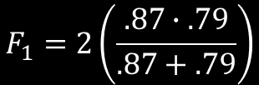
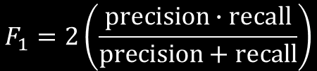
F₁ Score
Precision and recall are more useful in unbalanced datasets.
They come with a tradeoff.
Not always clear which metric is more useful.
A false positive may be just as undesirable as a false negative.
F₁ score helps you find optimal combination of both precision and recall.
$$F_{1}=2\left(\frac{precision∙recall}{precision+recall}\right)$$
$$F_{1}=2\left(\frac{.87∙.79}{.87+.79}\right)$$
Resulting F₁ score is around 83%.

Slide 65

Specificity
True Negatives
Correct negative estimations
$$\frac{TN}{TN+FP}$$
True Negatives
+ False Positives
All actual negatives
Drive failure model specificity: 98%.
Maximizes true negatives.
Not useful in all cases, especially with imbalanced datasets.
Customer attrition scenario based on satisfaction with a new product:
Satisfaction is positive, lack of satisfaction is negative.
Responses are balanced.
Maximize true negatives to reduce attrition from unsatisfied customers.
Might be a good case for specificity.

Slide 66

Receiver Operating Characteristic (ROC) Curve
1.0
Model A
Model B
Random guess
True Positive Rate
0.0
0.0
1.0
False Positive Rate
$$\frac{FP}{FP+TN}$$

Slide 67


Thresholds (Slide 1 of 2)
Actual negative
Actual positive
False positive
False negative
0.0
1.0
Estimation Probability

Slide 68
Thresholds (Slide 2 of 2)
Actual negative
Actual positive
True negative
False negative
0.0
1.0
Estimation Probability

Slide 69
Area Under Curve (AUC)
1.0
AUC = 0.88
True Positive Rate
0.0
0.0
1.0
False Positive Rate

Slide 70
Learning Curve (Evaluating Data Examples)
Training Score
Cross-validation Score
Logistic Regression Model
Random Forest Model
1.0
1.0
Accuracy
No convergence yet
Convergence
0.0
100
10,000
0.0
100
10,000
Data Examples
Data Examples

Slide 71
Learning Curve (Evaluating Bias and Variance)
High Variance
Low Variance
1.0
1.0
Small gap
Large gap
High Bias
Accuracy
0.0
100
10,000
0.0
100
10,000
1.0
1.0
Low Bias
Accuracy
0.0
100
10,000
0.0
Data Examples
100
10,000
Data Examples

Slide 72
Guidelines for Evaluating Classification Models
Consider the significance of TPs, TNs, FPs, and FNs.
Use a confusion matrix to visualize these truth results.
Individual metrics:
Consider accuracy may not be useful with imbalanced datasets.
Prefer precision and recall when there is a class imbalance.
Prefer recall over precision when avoiding false negatives is crucial.
Be mindful of the tradeoff between precision and recall.
Use F₁ score when neither precision nor recall are more important.
Prefer specificity for maximizing true negatives in balanced datasets.
Generate ROC curve and AUC to compare TPR and FPR for all thresholds.
Generate learning curves to see if adding more data examples will have a benefit.
Generate learning curves to detect high bias and high variance.
Overall:
Consider there is no objectively correct metric for all problems.
Consider applying multiple metrics to the same problem.

Slide 73
Evaluating Classification Models

Slide 74
What type of data in your organization do you think might be conducive to classification?
Given the datasets you're likely to use and classification problems you're trying to solve, what evaluation metrics do you think you'll find most useful when tuning a classification model?

